Slide 1
The Sixth R of Data Analysis
Reliable, Representative, Replicable, Ready Reporting

Slide 2

What do I hope to address?
Introduction
What is R and why should I use it?
Application
Making a table and a chart, the easy and repeatable way.
Integration and Iteration
Making charts and tables is a good start, but now it’s time to scale up.
Performance
I love using R and I now want it to do EVERYTHING! How do I make it go faster?

Slide 3
Standing on the shoulders of giants…
R for Data Science
https://r4ds.hadley.nz/
https://www.tidyverse.org/
Kyle Walker and Tidycensus
https://walker-data.com/census-r/
https://bsky.app/profile/kylewalker.bsky.social
Forecasting Principles and Practice
https://otexts.com/fpp3/
https://tidyverts.org/

Slide 4
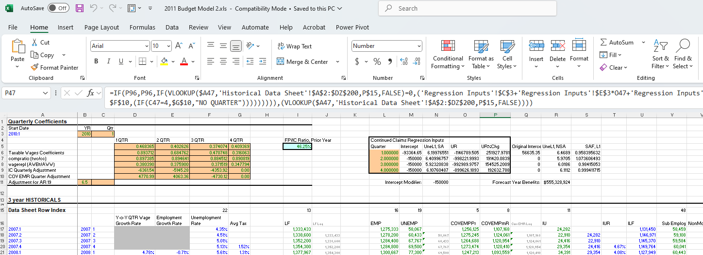
Once Upon a Time…

Slide 5
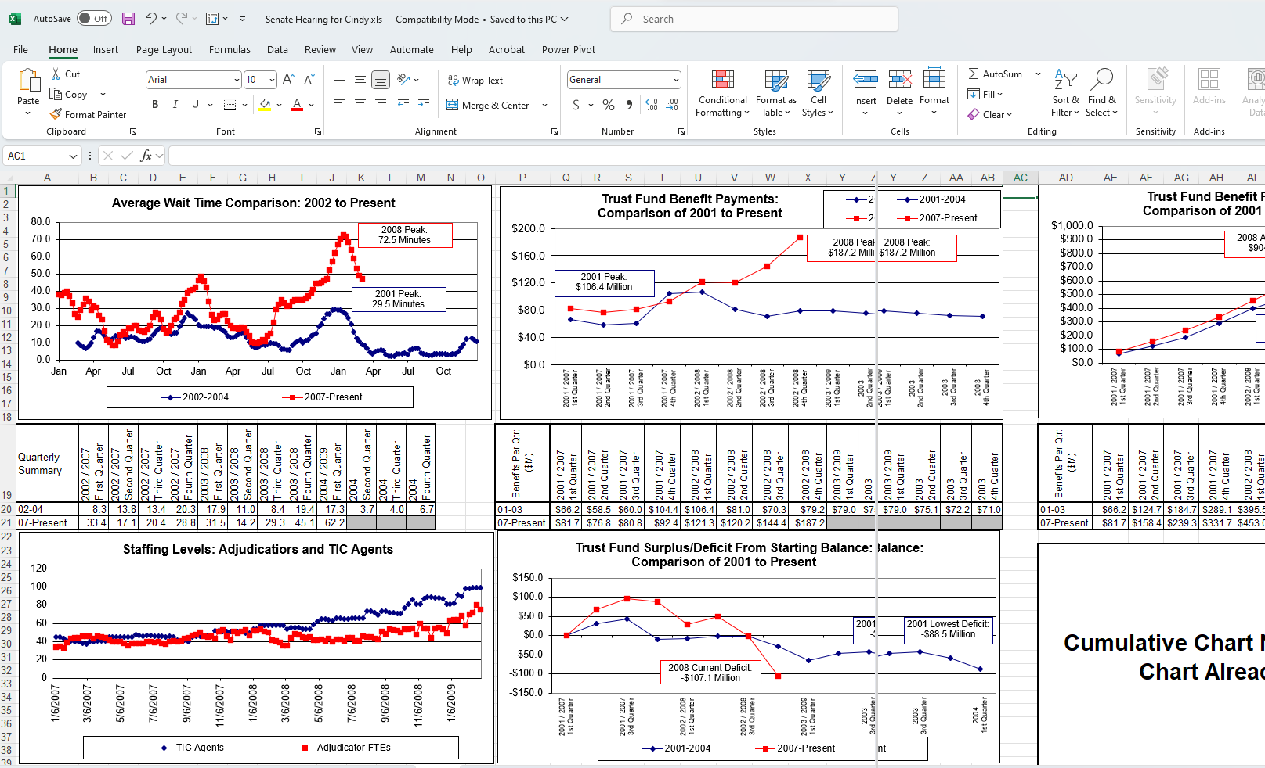

Slide 6
Recent Economic Updates
=IF(P96,P96,IF(VLOOKUP($A47,'Historical Data Sheet'!$A$2:$DZ$200,P$15,FALSE)=0,('Regression Inputs'!$C$3+'Regression Inputs'!$E$3*O47+'Regression Inputs'!$G$3*B47+(IF(C47=1,$D$10,(IF(C47=2,$E$10,(IF(C47=3,$F$10,(IF(C47=4,$G$10,"NO QUARTER"))))))))),(VLOOKUP($A47,'Historical Data Sheet'!$A$2:$DZ$200,P$15,FALSE))))
VLOOKUP
SUMIFS
INDEX(MATCH)
IFERROR
{Array Formulas}

Slide 7
Why Excel?
Availability
Price
Power
Familiarity
Flexibility

Slide 8

Recent Economic Updates

Slide 9

Excel R
Availability
Price
Power
Familiarity
Flexibility

Slide 10


What is it?
A highly extensible language and environment for statistical programming and graphics.
https://www.r-project.org/about.html
R Studio: software that provides additional ease-of-use in interacting with R.
https://posit.co/download/rstudio-desktop/
“Posit, RStudio, and Shiny are trademarks of Posit Software, PBC, all rights reserved, and may be registered in the United States Patent and Trademark Office and in other countries.”

Slide 11

What makes R so powerful?
Packages are bundles of functions that build on the basic functionality of R to streamline workflow and integrate processes.
Packages take the foundation of R and build a huge variety of amazing options.
CRAN provides a free repository of packages which meet certain requirements in a central location.
Anyone can build their own packages, too!
https://cran.r-project.org/

Slide 12
Recommended Packages
tidyverse - Bundle of workflow-related packages
tidycensus - Easy access to Census Bureau data
tigris - Easy access to Census Bureau shapefiles
sf - Tools for working with spatial data
tsibble - Working with time series data
openxlsx - Building Excel workbooks

Slide 13
Data Analysis Workflow Code at: https://github.com/schmidtDETR/OEWS-Mapping-and-Visualization
Question
What do wages look like in the construction industry?
Data Source
OEWS data from US Bureau of Labor Statistics flat files
Shapefiles from US Census Bureau
Cleaning
Convert data to numeric values
Combine county shapes for MSA and non-MSA OEWS Areas
Visualization
Table of employment and wages
Bar chart for median hourly wage
Map of wages in neighboring states

Slide 14

Data Sources – Your Superpower
BLS Flat Files: https://download.bls.gov/pub/time.series/ This has almost all the core BLS data, except QCEW.
FRED: https://fred.stlouisfed.org/ A massive reserve of economic indicators, *all* of which can be pulled straight into R using the tidyquant package.
LODES: https://lehd.ces.census.gov/data/#lodes Flat files for LEHD origin-destination data.
CPS Data: https://www.census.gov/data/datasets/time-series/demo/cps/cps-basic.html Raw CPS survey data.
UI Data Downloads: https://oui.doleta.gov/unemploy/DataDownloads.asp Flat file downloads, data maps, and report instructions for all UI reports.
QCEW Slices: https://www.bls.gov/cew/additional-resources/open-data/csv-data-slices.htm This gives you access to BLS QCEW data for all published areas.
Alternative Measures: https://www.bls.gov/lau/stalt-moave.xlsx Excel file with historical data for BLS alternative measures of labor underutilization for states.

Slide 15
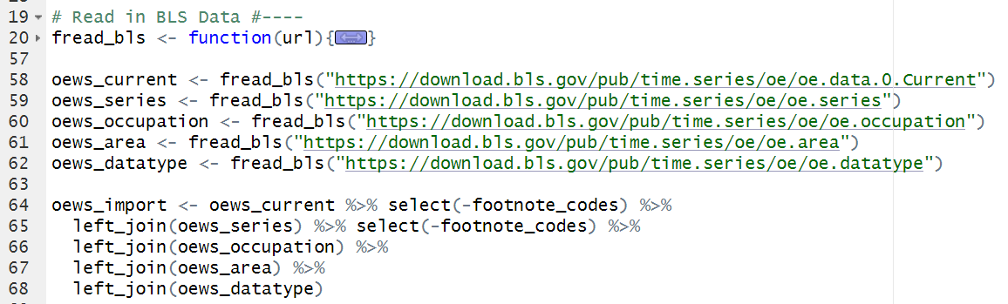
Getting the Data in R
Getting OEWS data from BLS – you can download the files manually, or you can use a script in R to go straight to the source.
I use a function so that I can eliminate manual steps in the process. The computer can do it, so I don’t want to waste time being a bad computer.
Data Source
After downloading the data, I join together the flat files, which are set up like a relational database.

Slide 16
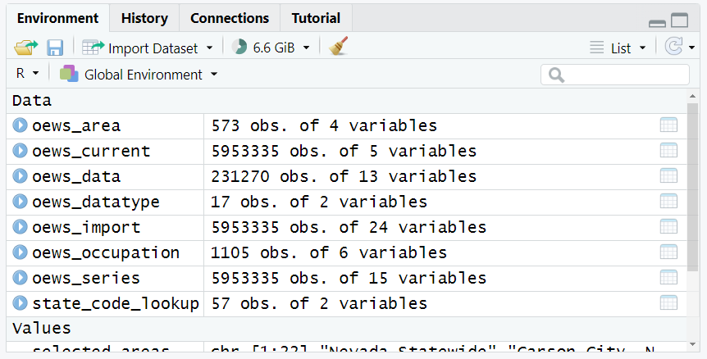
Getting the Data in R
Data Source
After I load the data, it appears in my “Environment” – the working space for data I have available to me.
6 million rows of data, all loaded, joined, and cleaned in 20 seconds. Sorry, Excel. You’ve just been left in the dust.

Slide 17
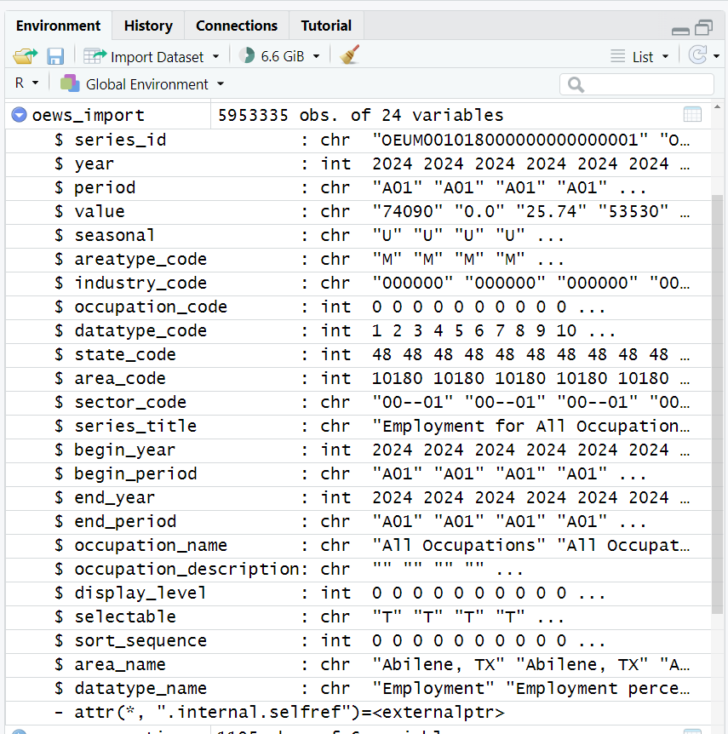
Getting the Data in R
Data Source
Looking at my joined data frame, I can see the columns (usually denoted with $ in R), as well as their data types.
As with any database-like structure, paying attention to data types can mean success or failure.
Knowing what we have, let’s start cleaning this up!

Slide 18
Cleaning the Data in R
I want to get this data ready to answer my questions: I want to know about employment and wages for selected occupations in and around Nevada.
Cleaning
I need my data values to be numeric, so that I can graph them like a number.
I want my different data types to be in columns, with the values below the data name.
I want to be able to sort the data in a way that shows Nevada first and other states second (for emphasis), and that shows statewide and then substate areas (for clarity).
I want some friendly names like “Nevada”, not “32”
Visualize
Clean
This is an iterative process!

Slide 19
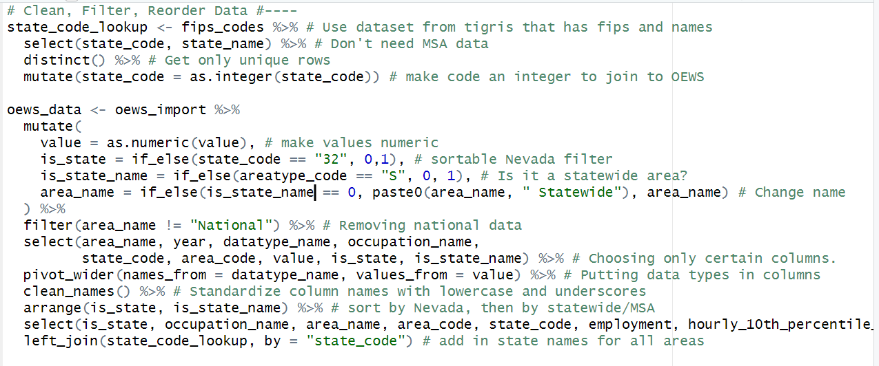
Cleaning the Data in R
Walking through a few key steps using tidyverse functions:
<-, %>%, mutate, filter, select, pivot_wider
Cleaning

Slide 20
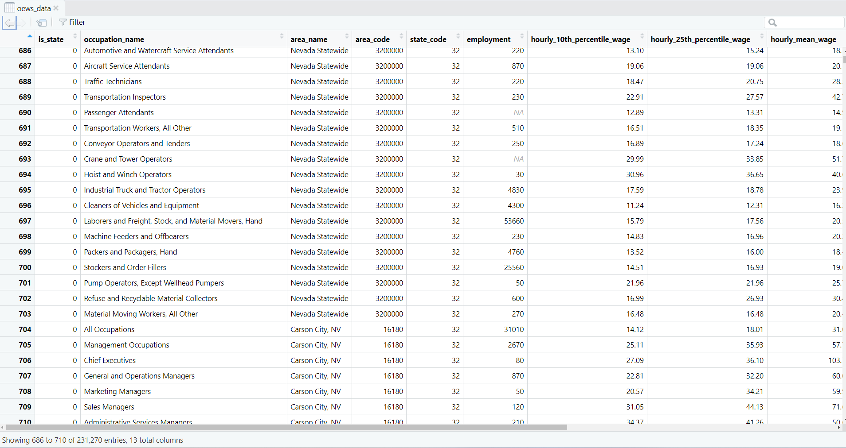
Cleaning the Data in R
Cleaning
A peak at what we have available now… looking good!

Slide 21
Visualizing the Data in R
Our data already looks kind of like the table that we want, it’s just too large to display in a pretty way (still 231,270 rows!). Now we’ll want to subset our data to display what we want.
Visualization
I want a table, to highlight some hard numbers for different data elements.
I want a bar chart highlighting wages within different states and how they vary.
I want a map, to highlight regional proximity in a way that separate bar charts do not.
Full Data
Viz Data
Viz Format

Slide 22
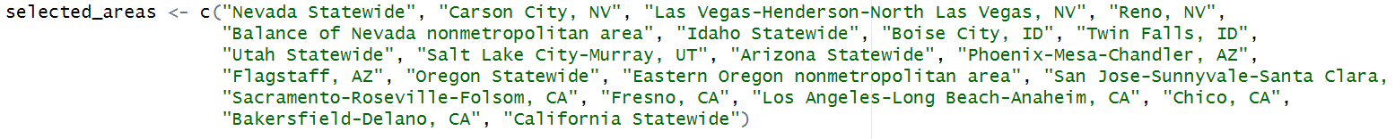
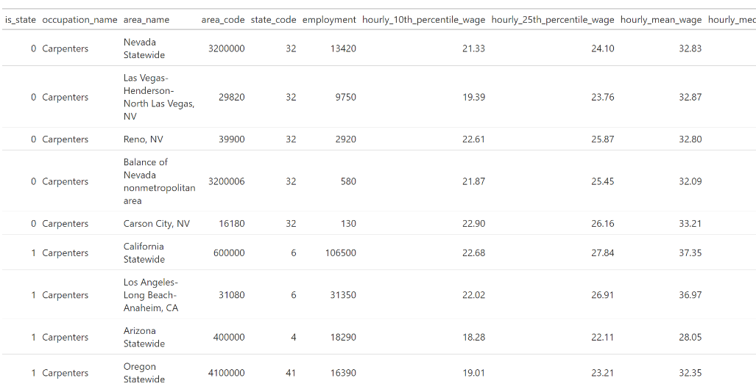
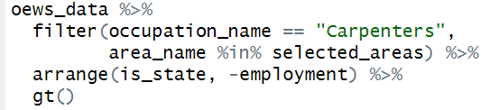
Visualizing the Data in R
I want a table, to highlight some hard numbers for different data elements.
I like to use the gt package for tables. https://gt.rstudio.com/
First, I’m spelling out what areas I want to include in my table.
Visualization
The basic table is simple, but just spits out the data the way it looks right now. To group it and make it pretty, we want to do a bit more.

Slide 23
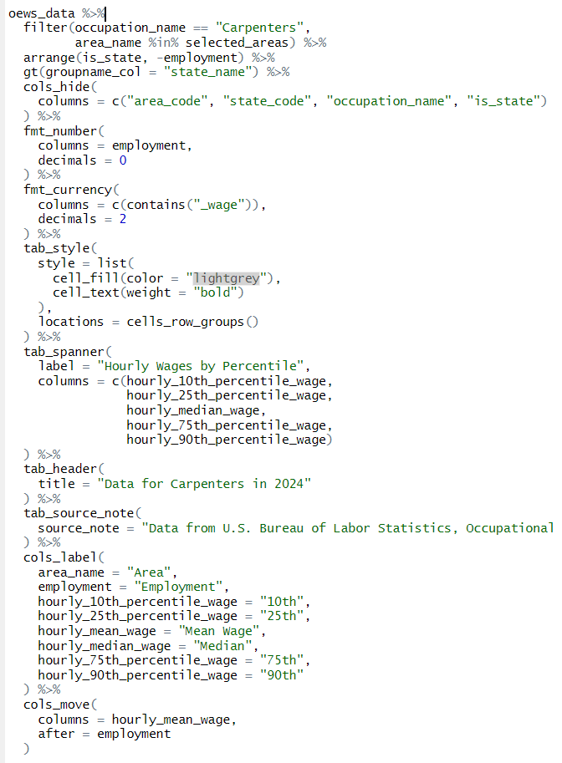
Visualizing the Data in R
Add a group name for each state to separate them visually.
Visualization
Hide columns we don’t need to show.
Format numbers with $ and , marks.
Format cells for state group names.
Add a group header for wage percentiles.
Add a title and footnote.
Rename columns with user-friendly labels
Move mean wage next to employment data

Slide 24
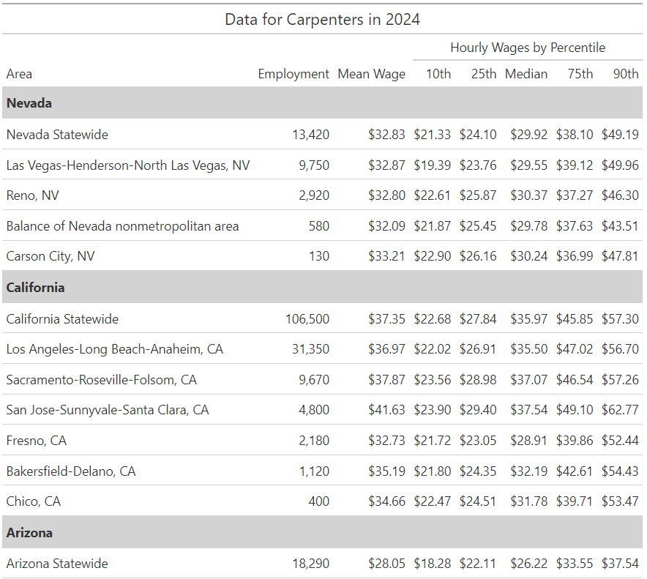
Visualizing the Data in R
Visualization
Formatting makes all the difference!
Remaining challenges:
Getting this to the recipient.
Scaling this up (we hard coded “Carpenters” as a filter and in the title).
We’ll come back to #2 soon!

Slide 25
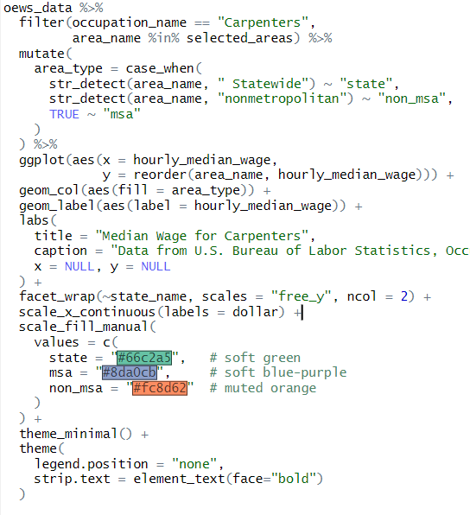
Visualizing the Data in R
I want a bar chart highlighting wages within different states and how they vary.
I want a map, to highlight regional proximity in a way that separate bar charts do not.
I will use ggplot2 to do each of these. https://ggplot2.tidyverse.org/
Visualization
Elements of a ggplot:
Data set – what are you plotting?
Mapping (aesthetics) – what data columns will define your dynamic variables – x, y, color, fil, size, etc? Uses aes()
Geometries – what shape will that mapped data take? Uses geom_()
Scales, Labels, and Beautification

Slide 26
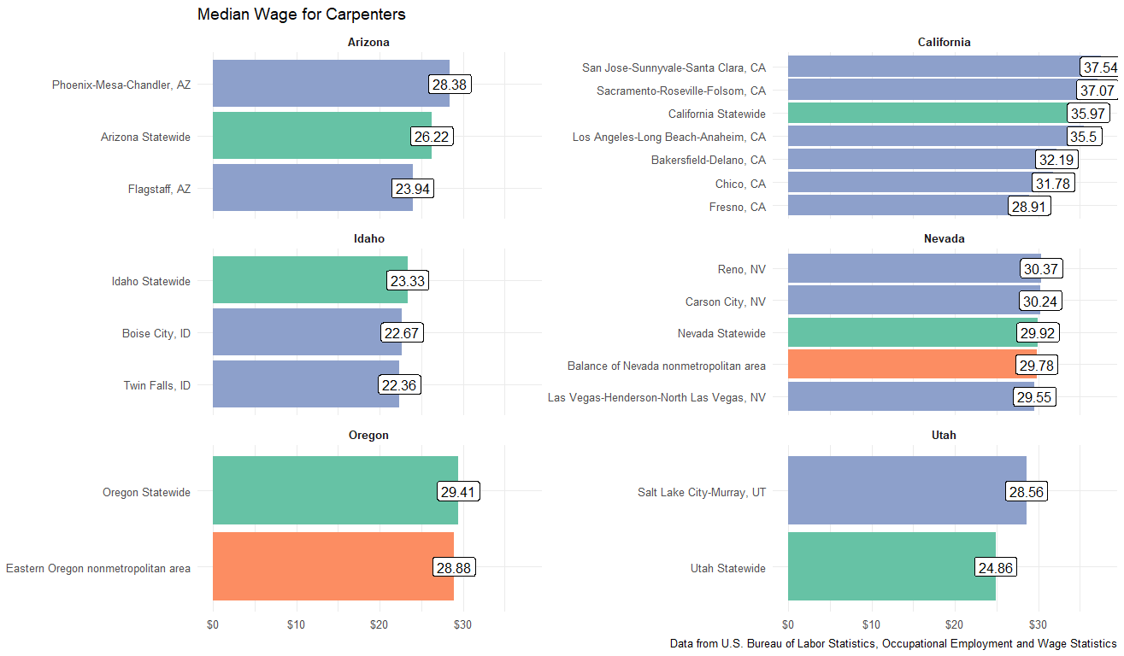
Visualizing the Data in R
Visualization

Slide 27
Visualizing the Data in R
I want a map, to highlight regional proximity in a way that separate bar charts do not.
To do a map, I need to get information about the geographic shapes I want to plot. OEWS does not produce data for all counties, but its data is built from counties. I need to start with county data and map those counties to the OEWS area definitions.
Visualization
OEWS Area Definitions
Available as an Excel document on BLS website under OEWS Methodology
County Shapefiles
Available using tigris package in R (or could download manually from US Census Bureau)
Joining data will require a common identifier to link the two

Slide 28

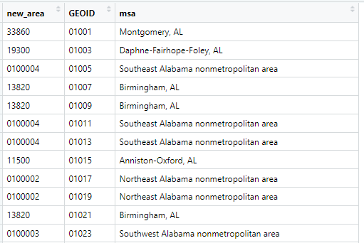
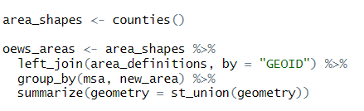
Visualizing the Data in R
I want a map, to highlight regional proximity in a way that separate bar charts do not.
Visualization
County Shapefiles + Merge
counties() gets all US counties via tigris
Join to OEWS definitions with GEOID
Group data by area code (“new_area”) and MSA name and combine shapes with st_union
OEWS Area Definitions

Slide 29
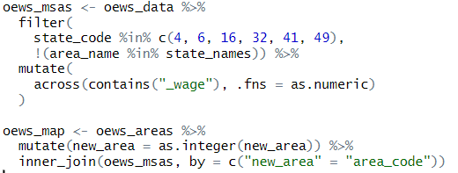
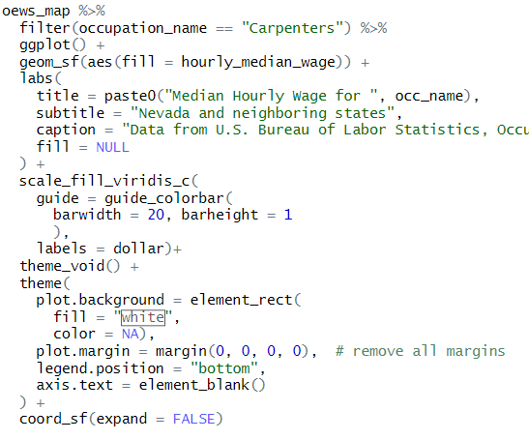
Visualizing the Data in R
I want a map, to highlight regional proximity in a way that separate bar charts do not.
Visualization
Elements of a ggplot:
Data set – what are you plotting?
Mapping (aesthetics) – what data columns will define your dynamic variables – x, y, color, fil, size, etc? Uses aes()
Geometries – what shape will that mapped data take? Uses geom_()
Scales, Labels, and Beautification

Slide 30
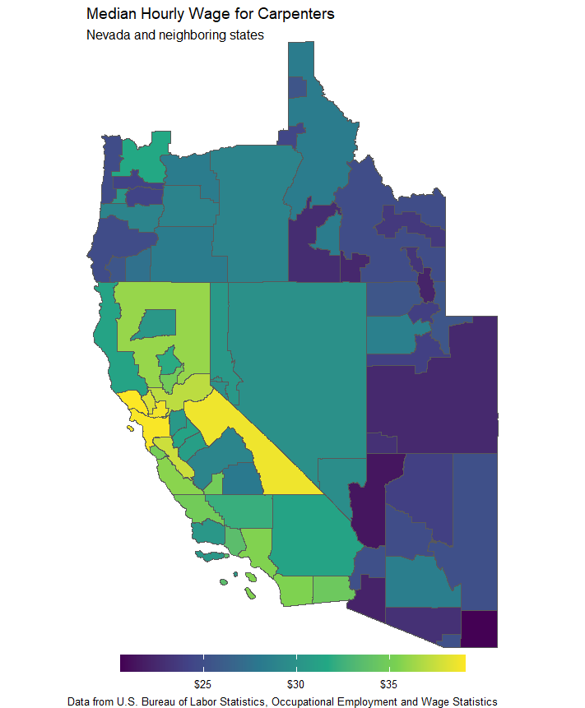
Visualizing the Data in R
We have all three visualizations! Investing in cleaning the data makes different variations on visualization much easier!
Visualization
But that was a lot of code that specifically references “Carpenters”. It’s hard-coded as a filter and typed in as the title. How do we scale this up? Right now, we’re not doing much more than Excel can easily do.
To scale up, we want to be able to iterate our analysis and to integrate those outputs into a finished product.

Slide 31
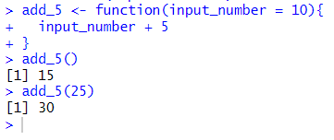
Iterating with Functions
If you are copying and pasting code, you should write a function!
As you tweak your code, using a function means you only make the change in one place, not every copy of it.
It’s built to apply the same logic to different inputs.
It’s easier than you think!
function_name <- function(variable_name = default_value, …){
**what it should do**
}
Creating a function called add_5 with a default value of 10. When called, it takes the input_number and adds 5. If no input_number is provided, it uses a default of 10.

Slide 32
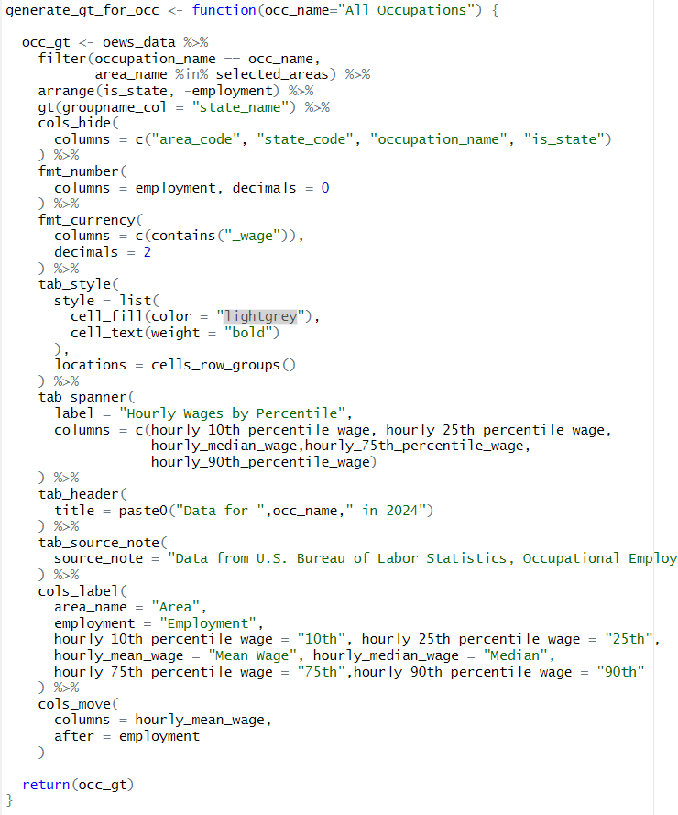
gt table: Original … and Function-al
Now I can make the same table for any occupation in the data with one line of code.

Slide 33
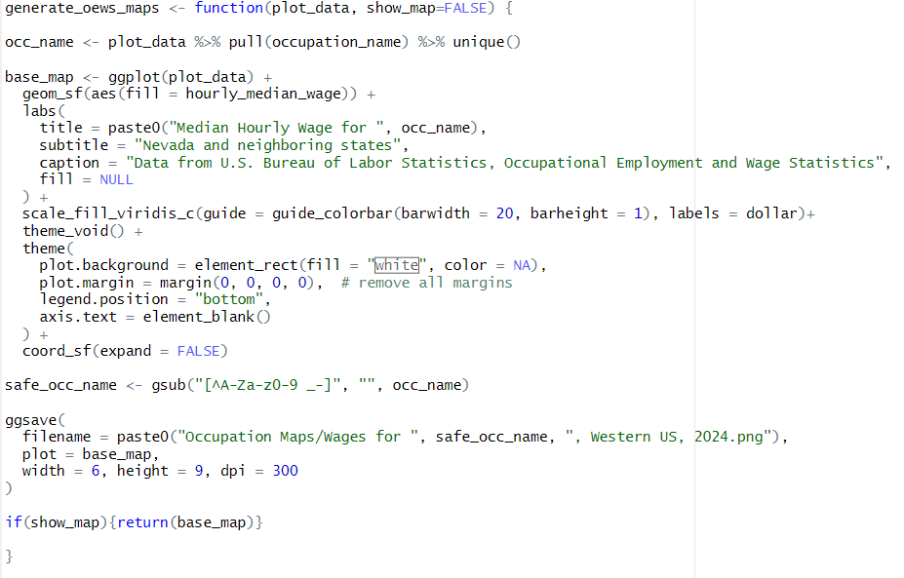
OEWS Mapping Function
Saving the image output to a unique file name in a dedicated directory. This will work magic.

Slide 34
Integrating with RMarkdown
If you want a report with multiple tables, maps, or plots – or if you simply want to include both text and outputs from R Code, it’s time to think about Rmarkdown or similar rendering options (e.g. Quarto).
R Script (*.R)
Processes the code. Good for processing content and saving *an* output to *a* directory.
Rmarkdown (*.RMD)
Integrates multiple chunks of code, output, and text into a finished document, then combines it all into a single product. Text, tables, charts, and more.
Can do MS Office documents, HTML documents, PDF outputs, and more.
Runs code in isolated environment, and makes results more replicable by others.
COMBINED?
Create the report layout in RMD, then call it in a loop in a script to iterate across multiple inputs!

Slide 35
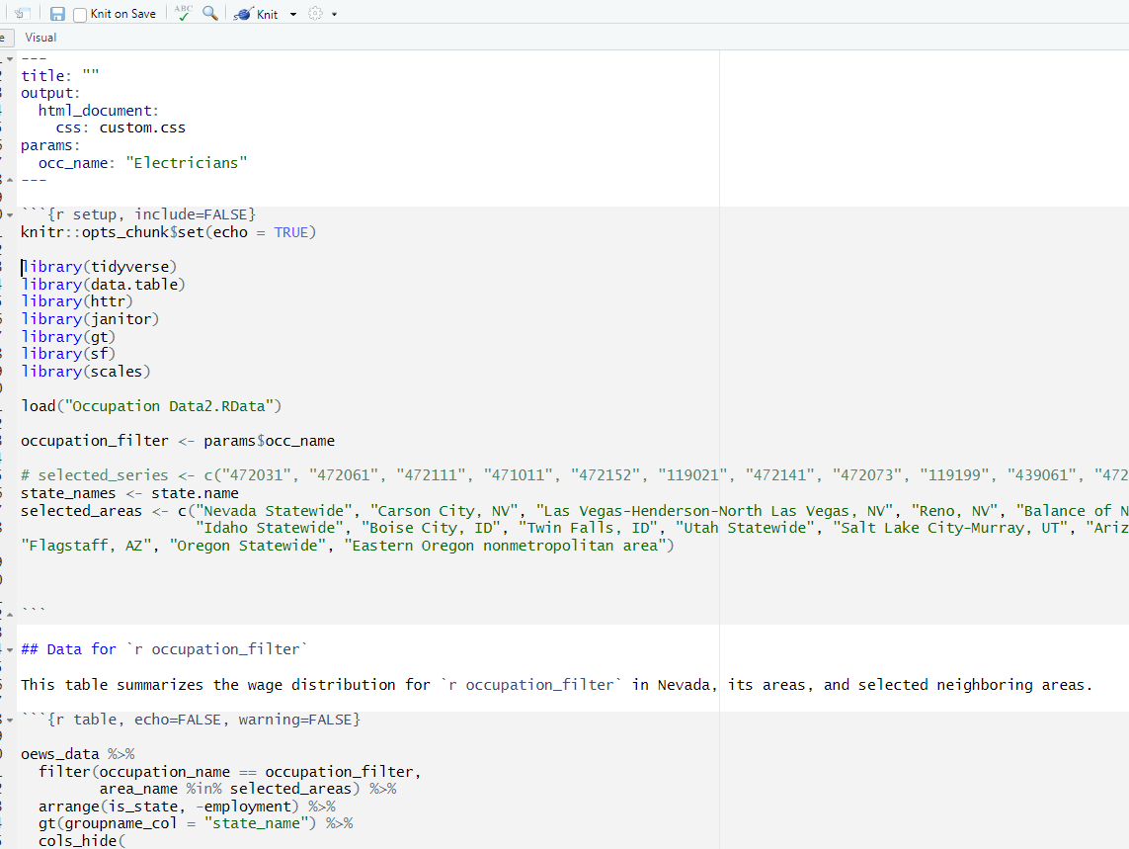
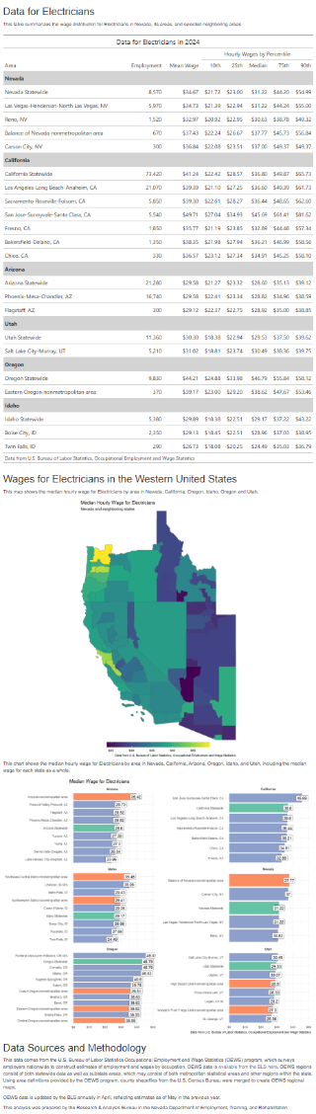
Integrating with RMarkdown
YAML header – defines document inputs and outputs broadly. Parameters provide a dynamic control.
Code chunk – executes code (not just R!)
Text block, can still include dynamic content
More code here (start of GT table)

Slide 36
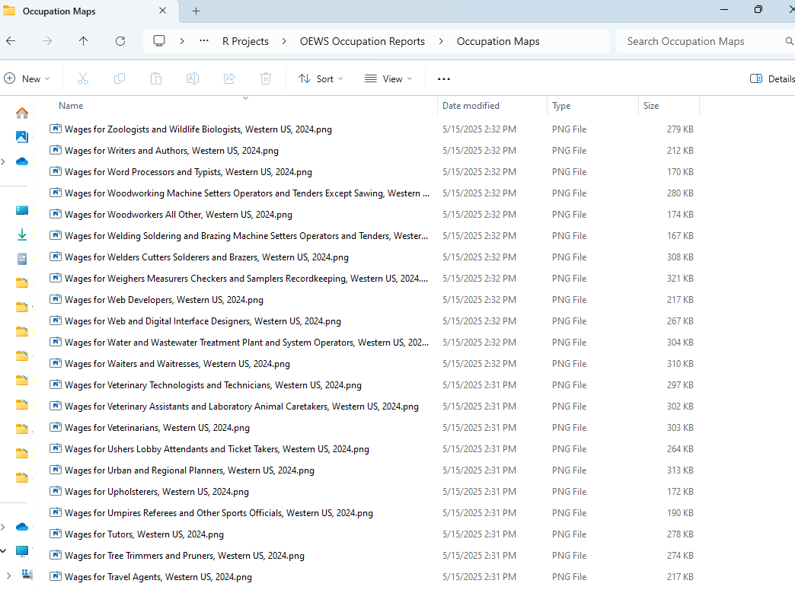
Don’t Be a Bad Computer!
You now have all the pieces to let the computer do the hard work. Don’t bother copying and pasting in every occupation – give your computer a list of occupations, and let it do all the work of pasting that list into your functions one at a time.
There are 628 occupations in the May 2024 OEWS data for Las Vegas, Nevada.
With a function in place, all I need to do is identify my list of occupation names in Las Vegas and then tell R to apply that function to every item in the list.

Slide 37
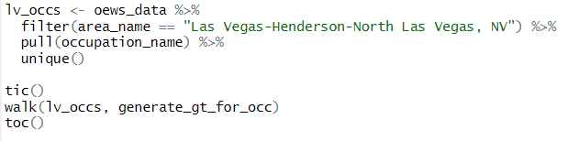

Scaling up with Iteration
If you build the process to generate your content correctly, the process of iterating is very simple – here, it takes just a couple lines of code.
This is all it takes:
Define what you want to serve as the inputs (here, unique occupation names in the Las Vegas area).
Use a function from the purrr package to apply the same function to a list of inputs. [Here using walk()]
It took the computer only 60 seconds to generate a GT table for every single occupation – the tic() and toc() give me timing benchmarks.

Slide 38
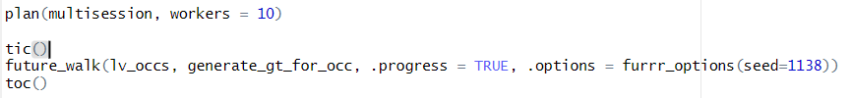
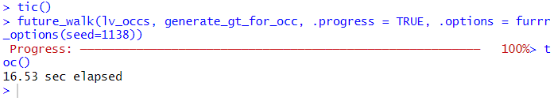
Don’t get bogged down!
BUT… by default, functions like walk() and map() don’t use all your computer’s resources well. They don’t use multiple CPU cores, and so everything is happening in a line. It’s time to speed up and run this thing in parallel. For this, we’ll use the furrr package. https://furrr.futureverse.org/
Setting # of workers limits # of CPU cores. Helps to avoid computer crashing.
Roughly 4x performance improvement!

Slide 39
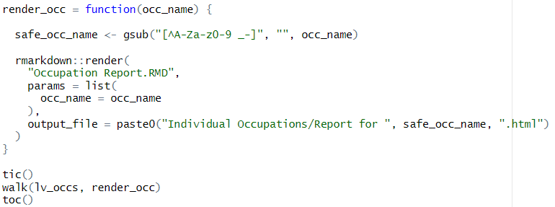
Combining Script and Markdown
Finally, let’s go back to our Markdown (RMD) document. We’re now going to use that script inside another script. We’re going to pass our list of occupations into the parameter in the YAML header to generate that report for every occupation in our list, and save those outputs each with their own unique file name.
This takes longer, but critically – it’s time your computer is working hard, but you can be doing something else.

Slide 40
But Why Would I Do This?
Eliminating the routine tasks frees you up to focus on analysis.
Don’t waste time being a bad computer.
Manual process restrict our capacity and put blinders on what we look at. Iterating through all the data broadens our perspective.
What was important yesterday may not be important tomorrow.
In times of diminishing funding, achieving efficiency is necessary to continue meeting the data needs we face.
Get busy living or get busy dying.

Slide 41

I Need More!
Learning R is much easier using GenAI: https://chatgpt.com/share/681ba433-af94-800c-a557-b5234f3e2929
Following R users on social media is a great prompt for ideas: https://www.linkedin.com/in/walkerke/
There are a lot of free resources available to watch and replicate code: https://www.youtube.com/watch?v=9a8_p_q4Z34&t=795s https://www.youtube.com/watch?v=8NKj8yF2gfo https://www.youtube.com/watch?v=4WZfw0K7Vx8
I help lead a monthly R user group focused on state workforce agencies. Sign up here >>>
Get code I used today from Github: https://github.com/schmidtDETR/OEWS-Mapping-and-Visualization

